Slide 1
October 4, 2018
Proximity correction in electron beam lithography
ChE 384T Graduate Student Presentation
Samuel allen
Electrical Engineering Graduate Student, The University of Texas at Austin

Slide 2
Outline
Review of E-beam lithography
Physical cause of the Proximity Effect
Proximity Effect in Action
Proximity Effect Correction Methods

Slide 3
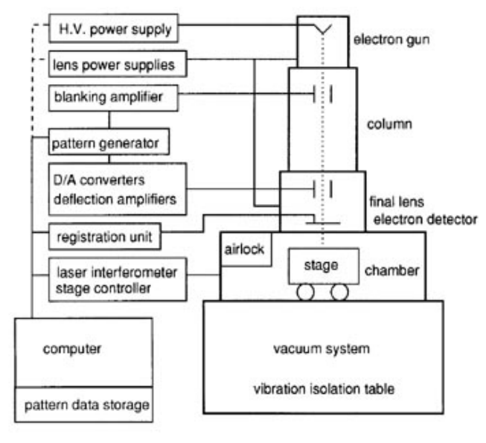
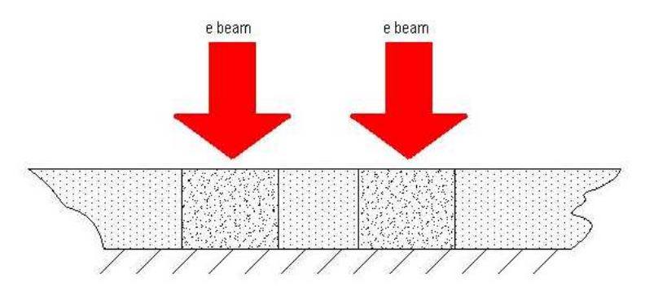
Electron Beam Lithography
Technique for creating extremely fine patterns
Works by scanning a beam of electrons onto a surface covered by resist
Energy is deposited in the resist, chemically changing it
Wash away exposed or unexposed area to continue patterning
Notes:
ADD Qualitative info

Slide 4
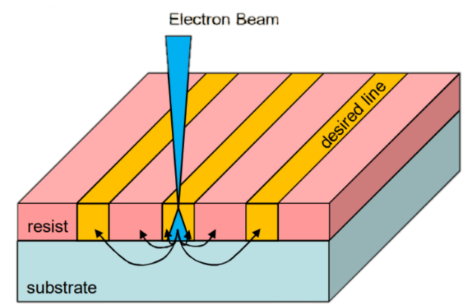
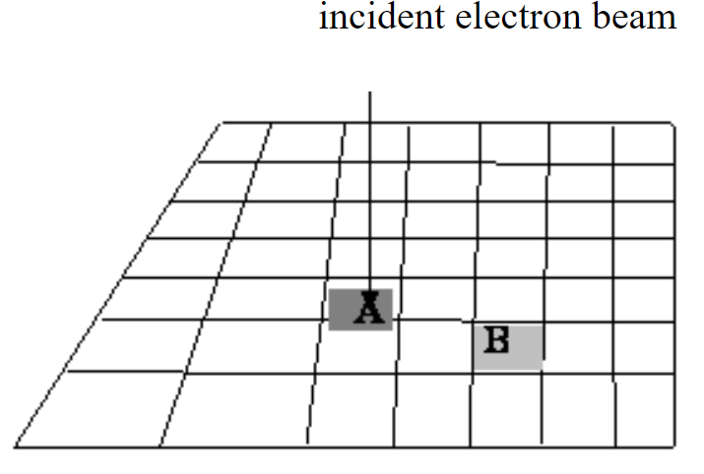
What’s the Problem?
Electrons in beam have energies of 10-100keV
At such high energies, the mean free path is large
> one order of magnitude larger than the resist thickness
Scattering takes place as electrons travel through resist and and substrate
Exposure at a certain area, affects a different area

Slide 5
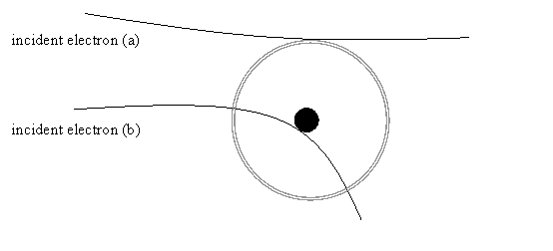
Forward Electron Scattering
Electron scattering due to electron cloud or nucleus
Transfer of energy and small directional change
Energy transfer can produce secondary electrons
If resist, this is cause of molecular chain breaking
Small scattering angle so NOT cause of proximity effect

Slide 6
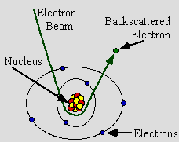
Backward Electron Scattering
Electron collides with nucleus
Only small energy transfer but big change in direction
After multiple large angle scattering events in the substrate, electron may return to resist a significant distance away from the beam
Causes additional resist exposure
Reason for Proximity Effect

Slide 7
Modelling Exposure Energy
Done with two or more Gaussians
One is forward scattering
One is backward scattering
Called Point Spread Function (PSF)
Energy deposited in resist as a function of distance from beam

Slide 8
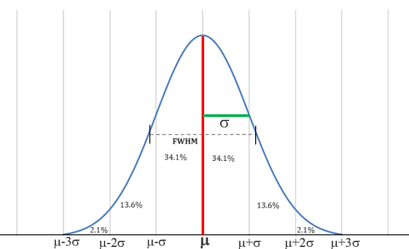
A bit about Gaussians

Slide 9
Exposure Energy at a Point

Slide 10
Put it all together for the PSF

Slide 11
Proximity Effect in Action

Slide 12
Corrected Proximity Effect

Slide 13
Dose Required to Correct

Slide 14
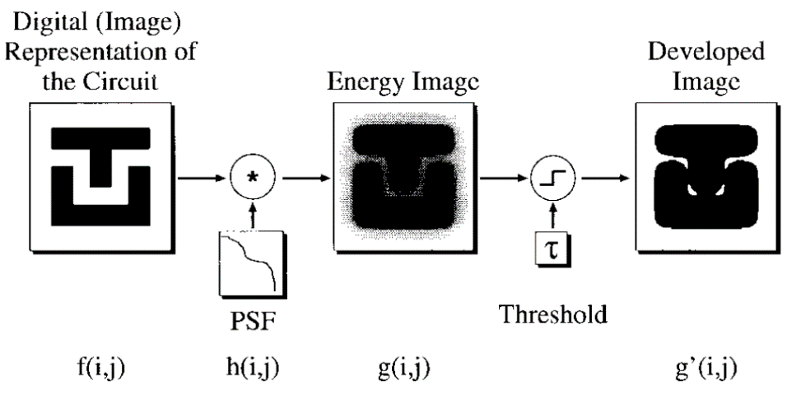
Exposure Estimation
Start with image you want
Convolve image with PSF to produce the energy profile of the image
Check whether each pixel of energy image meets threshold
Result is the expected developed image

Slide 15
Proximity Correction Methods
Monte Carlo Method
Shape Modification: PYRAMID
Background Exposure Correction: GHOST

Slide 16
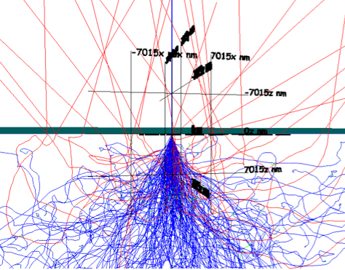
Monte Carlo Method
Numerical simulation of electron paths
As electrons pass through medium(s) energy is deposited in each pixel
Result is determination of dose in each pixel
Loop (hundreds of) thousands of times to find optimal dose at each pixel

Slide 17
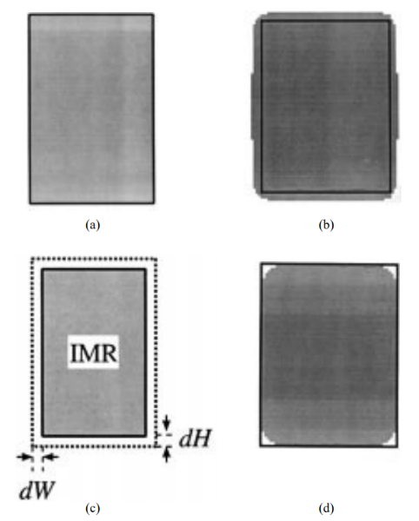
Shape Modification: PYRAMID
Single dose for entire circuit
Group circuit into rectangles
Collection of rectangles passed through a precalculated correction table
Finally, algorithm corrects for junction overlaps

Slide 18
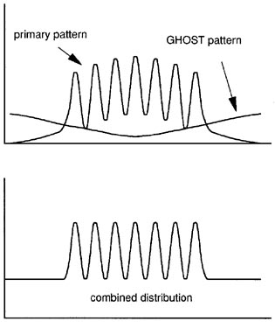
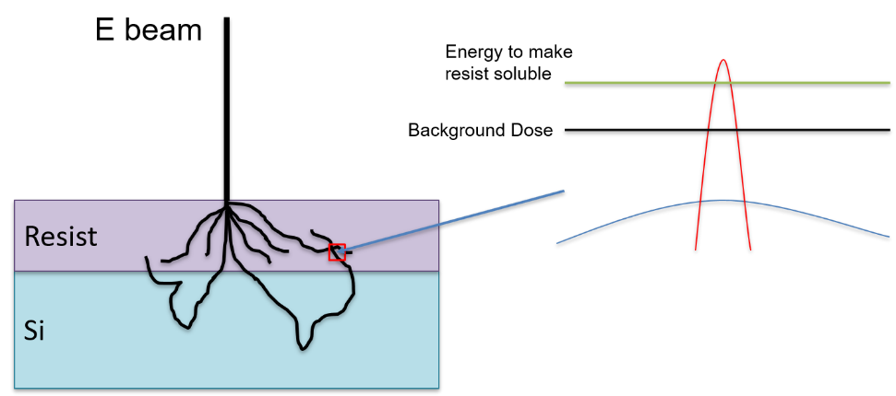
Background Exposure Correction: GHOST
Assume a certain energy to make resist soluble
Circuit given background dose that is inverse of intended image
Background dose brought to constant level
Greater than backscattered electron energy
Less than resist solubility energy

Slide 19
Conclusion
Proximity Effect is caused by backward scattering of electrons
Limits resolution of E beam Lithography
We seek to correct Proximity Effect by:
Monte Carlo Method
Shape Modification
Background Exposure Correction
Each method has it’s own trade offs

Slide 20
Questions?

Slide 21
E beam
Resist
Si

